Slide 1

WELCOME TO
OUR
SUPPLY CHAIN
PROJECT
Data analysis project
presented for DEPI

Slide 2












TABLE OF CONTENT
Main questions
Analysis
TRICK
DECISION
MAKING
INTRODUCTION
Analysis
VISUALS

Slide 3

FIRST OF ALL INTRODUCTION
WHAT IS SUPPLY CHAIN?
supply chain is the system that moves products from the manufacturer to the customer.
INRTO
QUESTIONS
ANALYSIS
VISUALS
DECISION

Slide 4
1-INTRODUCTION
Efficient supply chains are vital for business success, and data analysis plays a crucial role in optimizing them.
This project focuses on analyzing supplier performance, inventory management, production efficiency, and logistics to identify inefficiencies, improve decision-making, and reduce costs.
The insights gained will help [Company/Industry] streamline operations and enhance overall supply chain performance.
QUESTIONS
ANALYSIS
VISUALS
DECISION

Slide 5




1
2
3
4
5
Availability per Order Quantity
Defect rate per supplier
Most supplier facing issues
Cost/Routes Relation
BEST SHIPPING METHOD`
ANALYSIS
2-MAIN QUESTIONS
VISUALS
DECISION

Slide 6


3-ANALYSIS
ABOUT
TOOLS
MEASUREMENTS
LIBRARIES

Slide 7
3-ANALYSIS
ABOUT

Slide 8


3-ANALYSIS
( ABOUT )
Doability of the
production
Relationship between
Cost & Location
See if the production volume is applicable within
the order quantities or we need some improvements
See if the order is most of the times ordered to
Delhi and is stored in chennai instead of delhi etc.

Slide 9
3-ANALYSIS
ABOUT
MEASUREMENTS

Slide 10
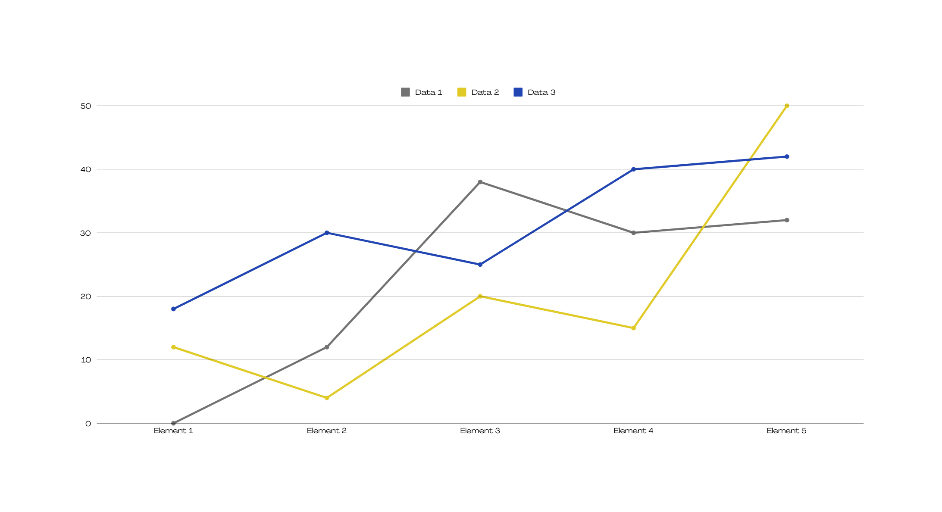
3- ANALYSIS
( Measurements )
3-
The Highest selling product
2-
Total Revenue for each supplier in this chain
1-
Avg. revenue to each product type

Slide 11
3-ANALYSIS
ABOUT
TOOLS
MEASUREMENTS

Slide 12
3- ANALYSIS
( TOOLS )
1
2
TABLEAU
PYTHON
FOR VISUALIZATIONS
FOR
CLEANING

Slide 13
3-ANALYSIS
ABOUT
TOOLS
MEASUREMENTS
LIBRARIES

Slide 14
3- ANALYSIS
( LIBRARIES )
1
2
TABLEAU
PYTHON
FOR VISUALIZATIONS
FOR
CLEANING
“PANDAS”

Slide 15



4-VISUALS
Stage 2
01
02
03
GUESS THE TRICK
Stage 3
Stage 1

Slide 16
4-VISUALS
01
Stage 1
MANUFACTURING
02
Stage 2
SUPPLY
03
Stage 3
SHIPPING

Slide 17
4-VISUALS
01
Stage 1
MANUFACTURING

Slide 18
4-VISUALS
01
Stage 1
MANUFACTURING
02
Stage 2
SUPPLY

Slide 19
4-VISUALS
01
Stage 1
MANUFACTURING
02
Stage 2
SUPPLY
03
Stage 3
SHIPPING

Slide 20
5-DECISION MAKING
CHALLENGES
Recommendations
Addressing these challenges was essential for ensuring accurate insights and reliable recommendations
Based on the comprehensive analysis conducted through the dashboards and the insights gained, several actionable recommendations can be made to enhance supply chain performance:
STAGE 1
STAGE 2

Slide 21


Slide 22
5-DECISION MAKING
01
Inconsistent Data Entries
Minor inconsistencies were found in supplier names, product types, and other categoricalvariables. These inconsistencies could potentially skew results if not corrected.
CHALLENGES
02
Missing Values:
The "Inspection Results" column contained "Pending" entries, which posed a challenge in measuring defect rates comprehensively. These entries needed careful consideration in the analysis to avoid misleading conclusions
Addressing these challenges was essential for ensuring accurate insights and reliable recommendations
03
Outlier Detection
Outliers in manufacturing costs and defect rates were identified. Distinguishing between genuine data points and entry errors required additional investigation, impacting the time spent on the analysis.
STAGE 1
04
Tool Limitations
While both Python and Tableau are powerful tools, they come with limitations. For instance, Tableau can sometimes struggle with extremely large datasets, leading to performance issues. Adequate hardware and data preparation strategies were necessary to mitigate these issues.

Slide 23
5-DECISION MAKING
01
Optimize Shipping Costs
A review of shipping practices is advised to reduce costs, possibly by renegotiating carrier contracts or exploring alternative routes. Using more cost-effective transport modes could yield significant savings.
Recommendations
02
Supplier Performance Management
Suppliers with high defect rates should undergo quality improvement initiatives like workshops or stricter inspections. Diversifying the supplier base can reduce risks from reliance on underperforming suppliers.
Based on the comprehensive analysis conducted through the dashboards and the insights gained, several actionable recommendations can be made to enhance supply chain performance:
03
Enhance Inventory Management
Robust inventory management, such as just-in-time systems, is essential for aligning stock with demand, reducing excess inventory, and ensuring availability of high-demand products.
STAGE 2
04
Improve Geographic Cost Efficiency
To address inefficiencies in geographic disparities, relocate inventory closer to key markets, such as moving products for Delhi from Chennai, to optimize logistics and cut transportation costs.

